Slide 1
DOF Guide for Budget Managers/Administrators
Office of Dean of Faculty
Hamilton College
Updated on 1/26/2021
Created on 10/9/2020

Slide 2
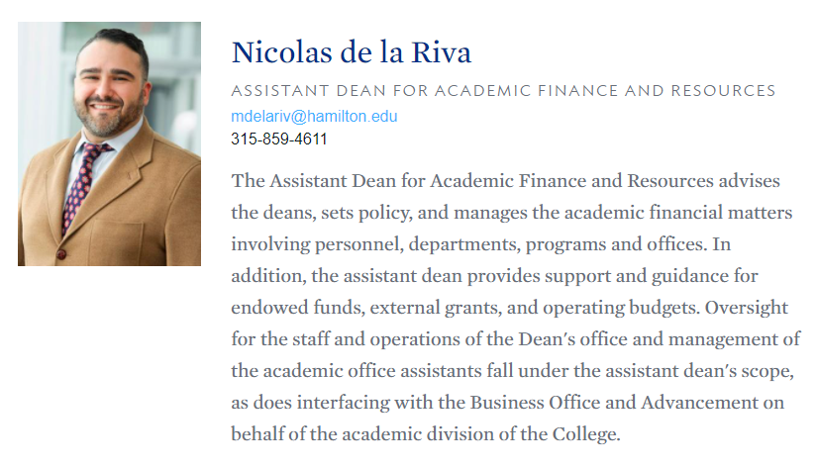
Introduction
The Dean of Faculty is pleased to provide this guide as a resource for Department Chairs, Program Directors, Budget Managers/Administrators, or others providing budget support.
This guide outlines the budget policies, timelines of the budget process, and both day-to-day and annual budget procedures.
If you have any questions or suggestions with respect to this guide or other budget related matters, please contact Nicolas de la Riva (mdelariv@Hamilton.edu or 315-859-4611).
Note to click on the hyperlinks throughout this guide, you need to be in Slide Show view.

Slide 3
Table of Contents
A. Budget Process
Annual Budget Planning Process
Budget Cycle / Notable Dates
Budget Monitoring and Reporting
DOF’s Budget Profile
B. Budgeting “101”
What is an account number?
Commonly Used Object Codes
Reimbursable and Non-Reimbursable Expenses for Travel
Reimbursable and Non-Reimbursable Expenses for Others (Not-Travel Related)
FAQs
C. “How To” Section
View Budgets in the Budget Tool
Make small dollar and large dollar purchases
D. Frequently Viewed Policies, Guidelines, and Forms

Slide 4
Budget Process

Slide 5
Annual Budget Planning Process: DOF Perspective
DOF plans and budgets according to what is important (strategic plan) and necessary to support the College’s educational goals.
Bottom up based on prior year budgets with adjustments for strategies or other driving forces.
Look at qualitative inputs such as behaviors and business practices.
Look at quantitative inputs such as enrollments, revenues, expenses, and budget results from prior years.

Slide 6
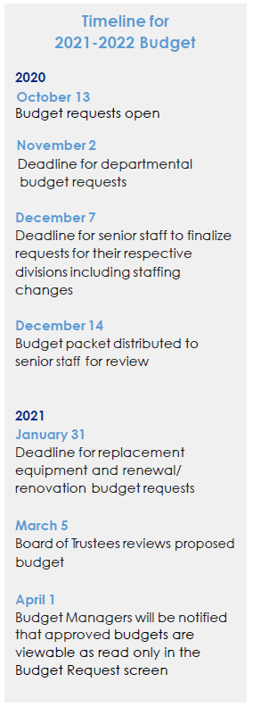
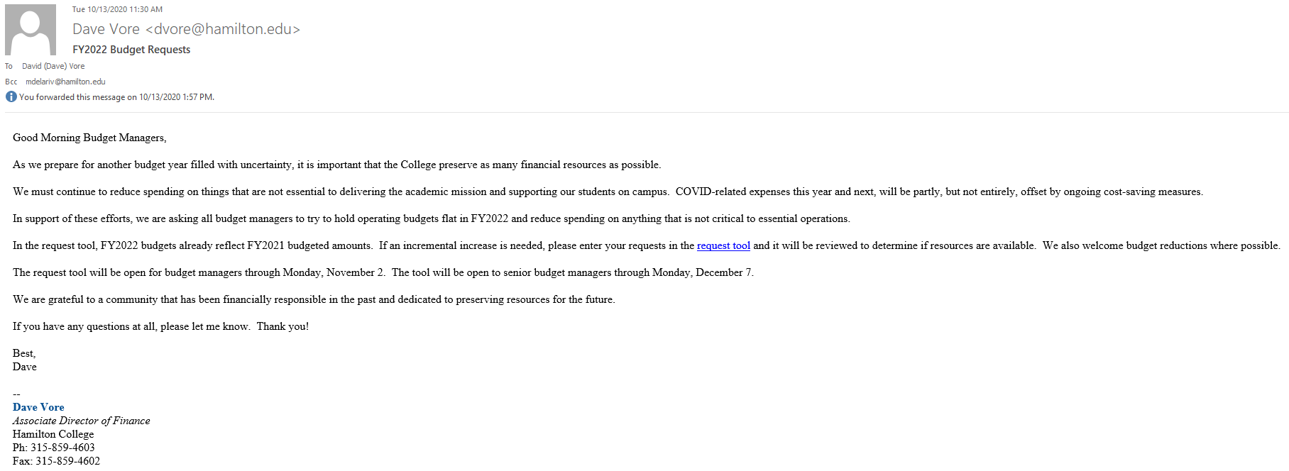
Annual Budget Planning Process: Overview
The budget request process is an annual planning exercise for operating budgets which includes non salary expenses such as student help, office supplies, printing, entertainment, classroom supplies, etc.
The Business Office generally launches the annual budget planning process for the new fiscal year in October with an email to budget managers.
The email contains instructions and forms for budget reallocation, equipment requests, and requests for additional funding.
If you do not need to move budgets between accounts, and do not have additional requests, you do not need to do anything further.
Approved amounts for requests are typically communicated in late March, after the Board Meeting.
Budgets for the new fiscal year may be seen in the budget tool in April.

Slide 7
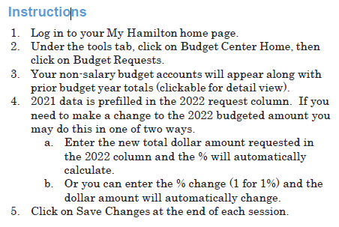
Annual Budget Planning Process: Budget Planning Request Screen

Slide 8
Annual Budget Planning Process: Capital and Technology Requests
Capital expenditures requested through forms.
Examples are office furniture and technology equipment such as microscopes, projectors, etc.
Must cost $500 or more.

Slide 9
Budget Cycle / Notable Dates
Hamilton’s budget fiscal year begins July 1 and ends June 30
July: New fiscal year begins on the 1st. Current fiscal year typically closes the 2nd week in July.
August: Audit of College’s finances for current fiscal year.
September: Audit of College’s finances for current fiscal year.
October: The annual budget planning process launched by the Business Office.
November: Deadline for departmental budget requests related to annual budget planning exercise.
December: Deadline for division budget requests related to annual budget planning exercise.
January: DOF conducts mid year check-in with budget managers/administrators. Deadline for all capital and technology requests related to the annual budget planning exercise.
February: DOF conducts end February check-in with budget managers/administrators, as needed.
March: Board of Trustees reviews proposed budget for new fiscal year. DOF conducts end March check-in with budget managers/administrators, as needed.
April: DOF conducts end April check-in with budget managers/administrators, as needed.
May: DOF conducts end May check-in with budget managers/administrators, as needed.
June: End of current fiscal year on the 30th. The Business Office notifies all campus employees with specific steps and deadlines as well as posts information online. Vendor invoices and reimbursements for the current fiscal year are typically due by mid-July. DOF conducts regular check-ins with budget managers/administrators, as needed.

Slide 10
Budget Monitoring and Reporting
DOF takes the perspective that the “bottom line” is the key to monitoring our budgets.
The Budget Tool, a system available for budget managers to utilize in order to manage respective budgets.
The tool can be accessed via My Hamilton -> Tools -> Budget Center Home -> Budget Reports.
Reporting is one of most valuable tools when it comes to overseeing budgets. It is through reports that data is presented in a concise manner for review and analysis. And reports sometimes even bring errors to light.
The DOF runs monthly reports to review burn rates (e.g. ratio to indicate how much spending and how quickly compared to the budget), and benchmark against historical trends. This is a useful exercise to check in with departments and forecast/anticipate end year outcomes.

Slide 11
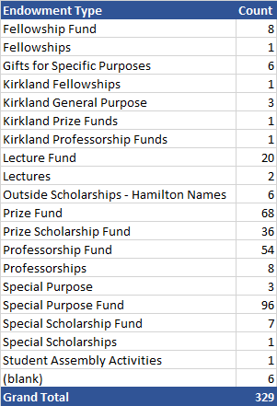
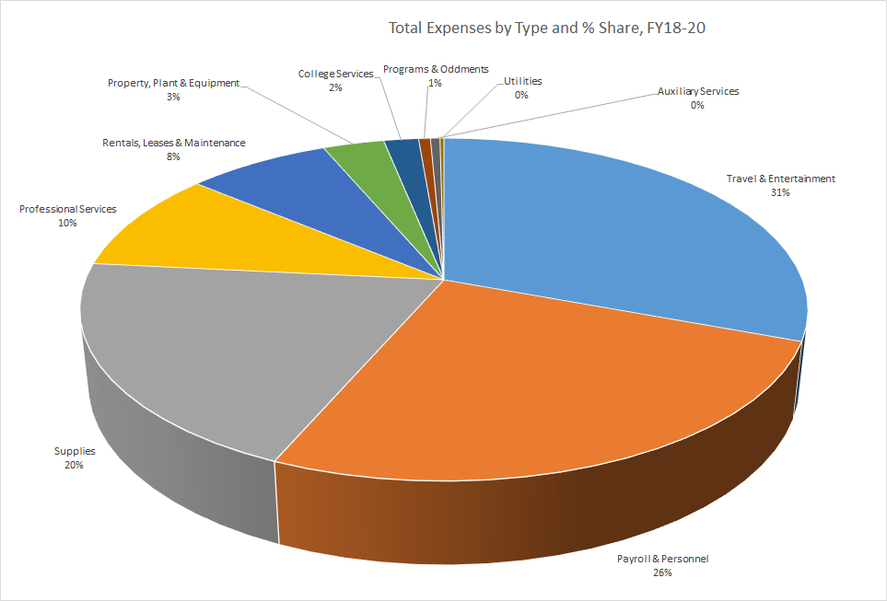
DOF’s Budget Profile
DOF’s budget is made up of 3 sources of funds: 1) endowments, 2) operating budget, and 3) grants.
Over 300 endowments are utilized to finance fellowships, lectures (speakers), professorships, and research support for faculty and students.
The operating budget supports travel & entertainment, supplies, student help, and part time wages in the academic departments, Athletics, DOF, domestic & abroad programs, the Academic Resource Centers, and Wellin Museum.
As of November 2019, DOF has 22 active grants from external agencies spanning multiple areas and donors from the prison program to the National Science Foundation.

Slide 12
B. Budgeting “101”

Slide 13
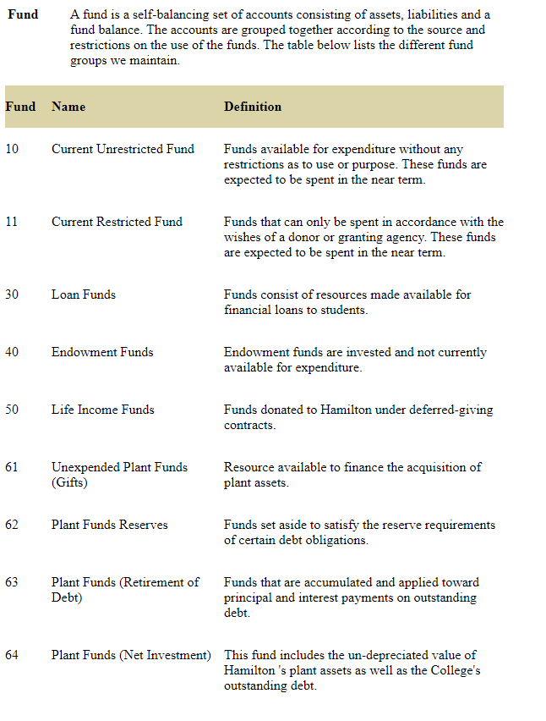
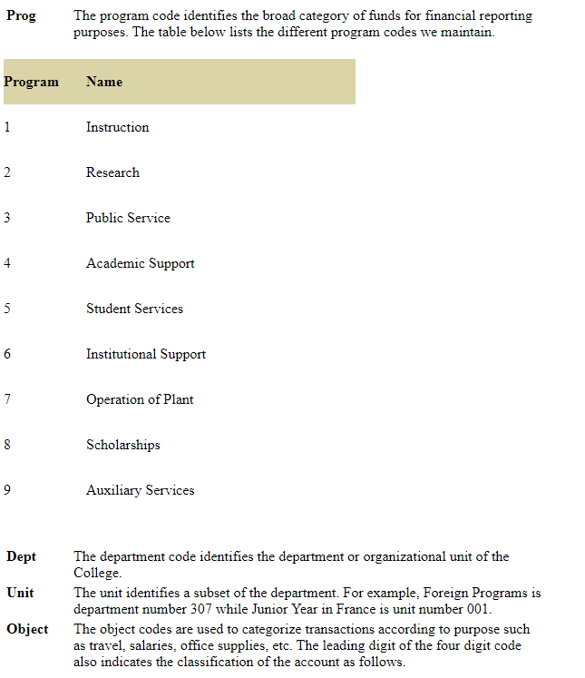
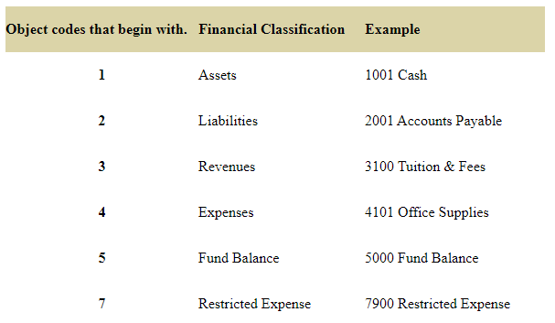
What is an account number?
An account number is used to track budgets and expenses. An account number consists of a fund, a program, a department code, a unit, and the object code.
Each account number is comprised of four fields and 13 digits. The basic construct is XX-X-XXXXXX-XXXX. Each field has a unique purpose as follows:
Field #1, fund field, (XX) – identifies whether the account is an operating account, in which case the first two digits are 10, or an endowed/gift account, in which case the first two digits are 11.
Field #2, program field, (X) – Identifies the broad category for financial reporting purposes. The most common for academic affairs are 1 (instruction), 2 (research), and 4 (academic support).
Field #3, department/unit field, (XXXXXX) – the first three digits of this field are unique to each department and generally begin with a 3. The second three digits encompass a subset of the department. For most departments there are no subsets, and the last three digits in this field are 001.
Field #4, object code, (XXXX) – expense line. The object code determines the type of expense, for example student help, printing and duplicating, and entertainment.
…”10-1-305014-4009”

Slide 14
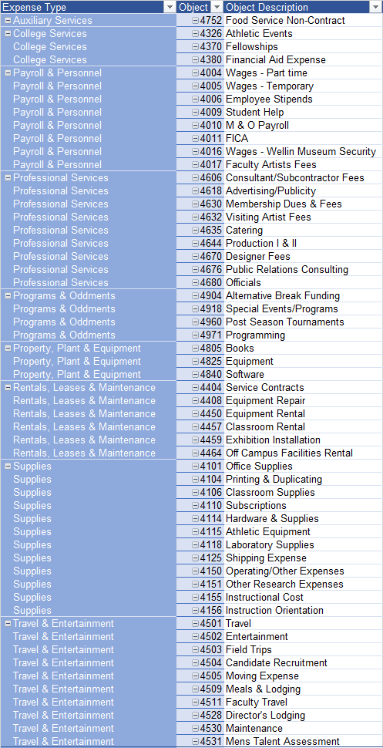
Commonly Used Object Codes
See complete list of codes

Slide 15
Reimbursable and Non-Reimbursable Expenses for Travel
Note that below lists of expenses are not meant to be all inclusive, they require prior approval, and they apply to all sources of funds.
Common reimbursable expenses related to travel on College business:
Airfare (coach class or equivalent) at the most reasonable rates.
Rental cars - Travelers should utilize rental agencies with which the College has negotiated discounted pricing as well as automatic tax exemption. Information on such agencies is available at http://www.hamilton.edu/offices/auxiliaryservices/travel/rental.
Employees using their personal vehicle for business travel may claim mileage allowance. The allowance is intended to cover all operation expenses such as insurance, gasoline, oil, tire and engine repair and maintenance. Costs of tolls and parking fees are reimbursable and not included in the mileage allowance. If a personal vehicle is used to travel to a single destination, the mileage allowance should not exceed what the cost of what air fare would be for travel to that destination.
Lodging. We will not reimburse for sales taxes in NYS (please reference the tax exemption homepage for additional information pertaining to other states). However, hotel reservations made through internet reservation services will be exempt from this policy as long as the room rate charged is less than the standard room rate charged by the hotel. Documentation provided with the reimbursement request must clearly indicate that an internet service was used.
Meals - $50 per diem up to 7 days maximum. A $50 daily per diem is normally permitted for meals when an employee is traveling on business for a full day. The general allocation of the per diem is $10 for breakfast, $15 for lunch, $25 for dinner. The daily per diem for faculty involving more than 7 days of travel is $25.
Expenses for modest gestures of appreciation for individuals who provided lodging to a college employee traveling on college business may be an allowable traveling expense unless the travel is to be charged to a federal grant or contract. The expense must be substantiated with a detailed receipt describing the item and include a brief explanation.
Baggage fees.
Conference and registration fees.
Ground transportation (tax, bus, subway, Uber, Lyft, etc.).
Parking and tolls.

Slide 16
Reimbursable and Non-Reimbursable Expenses for Travel (Continued)
Note that below lists of expenses are not meant to be all inclusive, they require prior approval, and they apply to all sources of funds.
We do NOT reimburse for:
Airline additional fees including pre-boarding, upgrades, in-flight headsets, seat selection, etc.
Passport renewal expenses
Unnecessary airfare costs or fees (added cost for extended trips, itinerary changes, cancellation, medical conditions)
Childcare
Kennel charges
Hotel laundry bills
Hotel phone charges that are not business related
Hotel room movies
Tips for hotel room service
Fitness club
Or anything not directly connected to attending a conference
Lost or stolen property, tickets, cash
Alcoholic beverages unless for authorized entertainment events
Damage to personal vehicles, clothing or other items
Fines, parking tickets
Expenses for family, spouses, and companions traveling with the employee unless there is a legitimate and approved business purpose.
Travel insurance
Restaurant Tips in excess of 20%
Baggage insurance
Costs incurred by unreasonable failure to cancel reservations
Lost baggage
Fines for traffic violations

Slide 17
Reimbursable and Non-Reimbursable Expenses for Others (Non-Travel Related)
Note that below lists of expenses are not meant to be all inclusive, they require prior approval, and they apply to all sources of funds.
Common reimbursable expenses for Others:
Meals with guest, such as candidates and speakers up to maximum of $150 (include names of attendees and itemized restaurant tab).
Total meal allowance for speakers up to $250. Total could be one meal with speaker up to $150 and balance for reception for a total of $250 or a reception totaling $250.
Lab supplies.
Equipment.
Publication costs incl. subventions, indexing, proofreading that are directly related to promotional cases or research.
Unless such a purchase pertains to employee travel on college business, all purchases of alcohol from College funds must be approved by the appropriate member of senior staff or their approved delegate. The College’s policy regarding the purchase of alcohol while traveling on College business is described in the Meals and Entertainment section of the College’s travel policy.
In accordance with IRS regulations, meal expenses not requiring an overnight stay or work day (including travel) exceeding 10 hours may be reimbursed, but are generally not considered tax exempt. If an employee submits an approved expense report for meals not involving overnight travel or workday exceeding 10 hours, the appropriate payroll taxes will be withheld from the employee’s next salary payment. There are occasions in which meal costs not pertaining to travel are considered tax exempt. Such occasions are listed below. The meal is provided on an occasional basis to allow the employee to work overtime. The meal qualifies as a legitimate business expense, i.e. college business is conducted during the meal.

Slide 18
Reimbursable and Non-Reimbursable Expenses for Others (Non-Travel Related) (Continued)
Note that below lists of expenses are not meant to be all inclusive, they require prior approval, and they apply to all sources of funds.
We do NOT reimburse for:
Restaurant Tips in excess of 20%
Purchase one’s own publications
Cellphones
Childcare
Individual professional memberships to associations except when presenting at a conference
Flowers (except if coordinated with HR and purchased the “Hamilton Cares” program)
Software or data storage platforms that have equivalent support through LITS (i.e. Dropbox is not reimbursable since Google Drive is provided to all faculty), but specialized software is reimbursable; however, we encourage conversations with LITS for long-term planning purposes

Slide 19
FAQs
I just charged something on a line that does not have a budget. It is the responsibility of the department through its Chair to keep expenditures under each line item within the total amount allocated. In no case may total expenditures exceed the total budget. Note that lines with no money in them generally means that you cannot spend on those items. You may transfer funds between funded lines.
How do I fix expenses miscoded to the wrong account? Occasionally you may need to reallocate spending across budget lines for accounts under your control using the General Ledger Transfer option in the Budget Tool. An example of circumstances needing a transfer is printing expense that was charged to office supplies. To access the General Ledger Transfer tool, go to My Hamilton -> Tools -> Budget Center Home -> Transfers -> GL Transfer Request and follow the instructions. You will receive a confirmation/approval from the Business Office, usually within 24 hours.
Can I delegate budget administration and signing authority to others? It is not okay to delegate budget administration to anyone in your department. The ultimate responsibility for spending and managing department funds lies with the Department Chair/Director. However, budget support is encouraged and practiced throughout the College.
How do I find out how much money I have in my budget? Check the budget tool for information on your budget. See section on “View Budgets in the Budget Tool” for step by step instructions on how to access the system.
Who do I contact if I need a new account number created? Please send an email to Dave Vore (dvore@hamilton.edu) in the business office with copy to Nicolas de la Riva (mdelariv@hamilton.edu).
Who do I contact if I need access to the budget tool? Please reach out to Nicolas de la Riva (mdelariv@hamilton.edu) in DOF.

Slide 20
C. “How To” Section

Slide 21
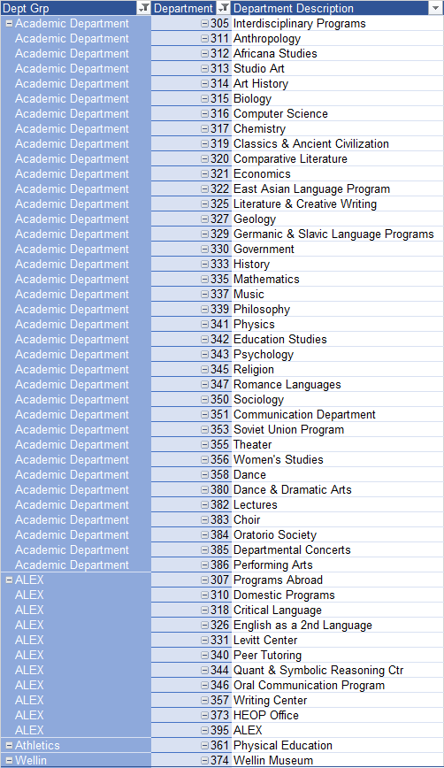
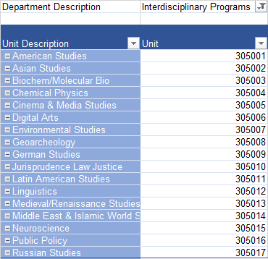
View Budgets in the Budget Tool
The tool can be accessed via My Hamilton -> Tools -> Budget Center Home -> Budget Reports. Once the tool is open, accounts will automatically display for your department.
If not displayed, a report can be run by entering the account number in the “Filter Results” box in the upper left corner. Note that a shortcut is to populate only the department field since the department number is unique to each department.
Do not change either the “Budget” box or the “Sort By” box as these are not necessary to change.
Click on the “Submit” button to run your report.

Slide 22
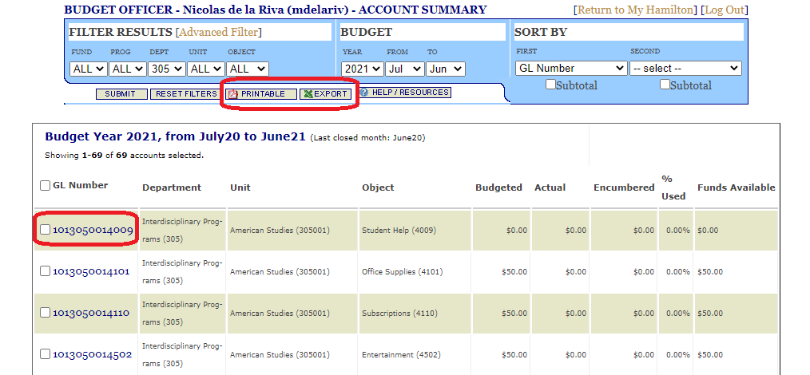
View Budgets in the Budget Tool
The tool will generate a report by account number (or GL number) and other financial details: budgeted, actual, encumbered, % used, and funds available.
At this point you have the option to either print in PDF, export the data in excel, or drill down by account number to view details.

Slide 23
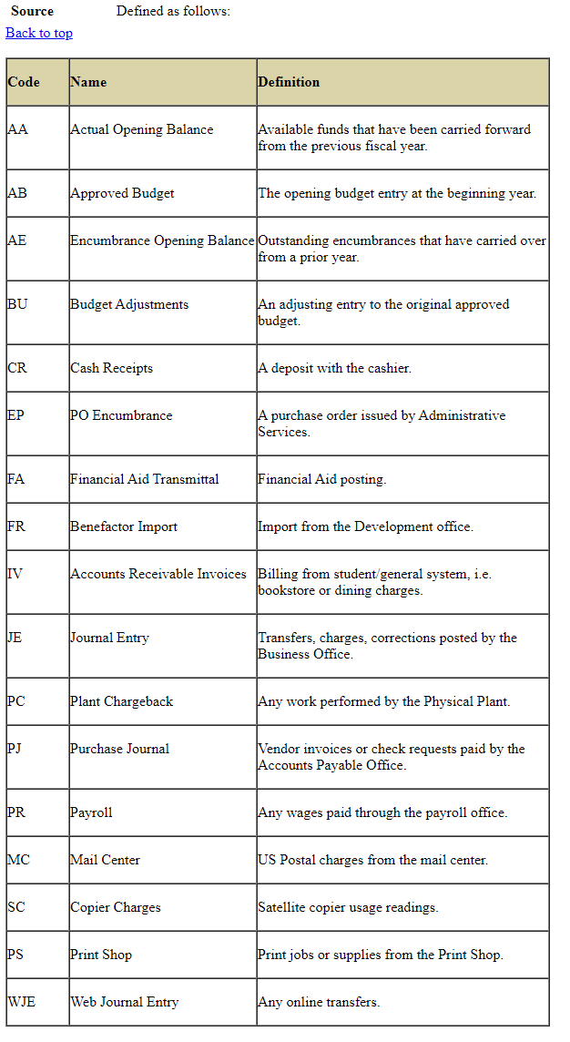
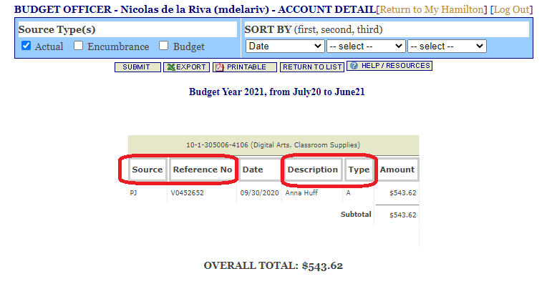
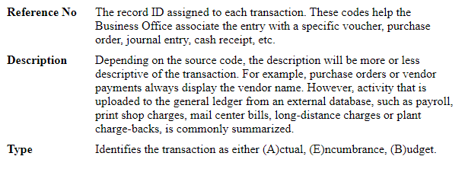
View Budgets in the Budget Tool
The drilldown option will provide some details relevant to the expense.

Slide 24
Make Small and Large Dollar Purchases
Purchases for the Department can be made in a number of ways.
Small dollar purchases may be done through a department corporate card, the preferred route, or individuals may submit a reimbursement through a check request form.
The College has an exclusive office supply contract with W.B. Mason. All office supply orders must be placed with W.B. Mason. Use of other vendors is prohibited. Orders can be placed online through your AOA.
Large dollar purchases should be made using a purchase order (PO). Complete the purchase requisition form and have it signed by the department head or other authorized individual and send to Lauri Swan, lswan@Hamilton.edu, in Auxiliary Services. For orders that are financed through a start-up fund or an endowment, please complete the requisition form and send to Nicolas de la Riva, who will then work with Auxiliary Services to create a PO.
All submissions must include the requisition form and relevant supporting documentation (i.e. the vendor quote and contract, if available). Note to ensure the College’s financial and legal interests, Auxiliary Services will need a few weeks to review the contract terms so please plan accordingly.

Slide 25
D. Frequently Viewed Policies, Guidelines, and Forms

Slide 26
Frequently Viewed Policies, Guidelines, and Forms
Spending Guidelines for AY 2020-21 – This document lists the spending restrictions applicable to FY21 due to the global COVID-19 pandemic.
Reimbursement Policies and Procedures – This document outlines procedures for submitting reimbursement requests when utilizing DOF funds and endowments for student entertainment, speaker related reimbursements, recruitments, faculty travel, and/or start-up funds.
Request for faculty travel funding – To request travel funds through the DOF for conferences or other research support trips, faculty must complete and submit this form which will be sent to the Associate DOF. In accordance with the Faculty Handbook, each faculty member will be reimbursed for the expenses incurred for one professional conference meeting per year. Additional conferences may be authorized by the DOF based on the availability of funds. If costs change significantly before travel (>5%), re-approval is required.
Travel Policy – This link contains policies that apply to all individuals whose travel expenses are paid by the College.
Request for Student Travel Funding - The DOF supports student travel if a student is a participant in the program and funds are available. We do not support travel that occurs after a student has graduated. The maximum award from DOF funds is $500. Please visit student travel support for additional information.
Field Trip & Excursion – This link describes the process for faculty to request off-campus trips with students as well as Off-Campus Study Office’s documentation requirements prior to departure.
Request for public speaker - DOF funds are available to support faculty-sponsored speakers only. All faculty, departments, programs, and academic offices wishing to invite a speaker to campus for a public event must complete a Request for Public Speaker Form before making a commitment with their guest. If only a classroom visit is planned and no funding is requested, a form is not needed. Please visit payments to foreign visitors for instructions related to foreign persons.
General Guidelines for Research Support – To request funds related to research expenses, all faculty must complete the research support form. The guidelines describe the areas of support for research expenses from hiring an individual to do a task to purchasing equipment or services from a vendor to research travel to hiring student workers.
Guidelines for Start-Up Funds – This link provides information for those faculty with startup funds. It outlines the processes to request and utilize your funds for research travel, equipment and supplies, and other needs relevant to your research work.
Guidelines for Endowed Chair Funds – These guidelines indicate the processes to request and utilize funds for faculty members who have received a professorship as an endowed chair.

Slide 27
Frequently Viewed Policies, Guidelines, and Forms (Continued)
Student Employment Guidelines – These guidelines provide the College’s processes to hire a student employee. Note that all forms must be completed and submitted to HR prior to commencement of work in order to avoid audit, financial, and legal risks.
Purchasing and Procurement – This section is meant to inform faculty and others the different ways to purchase goods and services from small to large dollar amounts.
Purchasing Card Policy – This policy outlines the College’s purchasing card program to buy goods and services that are $1,500 or less.
Computer Purchase Approval Form - This form contains instructions to request new computers/printers outside of the normal budget process. Persons requesting mid-year computer/printer purchases must first consult with Gretchen Maxam regarding appropriate equipment. After consulting with Gretchen Maxam and completing the Computer/Printer Purchase Request Form, the person requesting the equipment must seek approval by signature of the Dean of Faculty. A written justification must be included to define a clear statement of need and an explanation of why the need must be met prior to the next budget year.
Signature Authority for AP Transactions – This letter identifies appropriate signature authority for various AP transactions specifically within DOF, including academic departments and programs.
Contract Signing Policy – Senior staff members of the College are authorized to sign contracts on behalf of the College. This link identifies those staff members and identifies those who have been delegated authority to sign in certain areas such as the performing arts.
Tax Exemption – The College is a not for profit and is exempt from any and all sales tax in NYS. This exemption applies to hotels, meals, rental cars and business purchases. Effective January 1, 2006, New York State sales tax paid on College purchases will not be included in reimbursements for retail purchases, hotel accommodations or meal charges in excess of $100. This section provides information and the processes to follow in order to ensure tax exemption in New York as well as other states.
Guidelines for Celebrations – These guidelines are intended to help supervisors know what the College will reimburse for celebrations, including employee length of service, retirement, or departures. The College does not pay for gifts for student workers.
Alcohol Policy - Unless such a purchase pertains to employee travel on college business, all purchases of alcohol from College funds must be approved by the appropriate member of senior staff or their approved delegate. The College’s policy regarding the purchase of alcohol while traveling on College business is described in the Meals and Entertainment section of the College’s travel policy.

